Slide 1


Slide 2
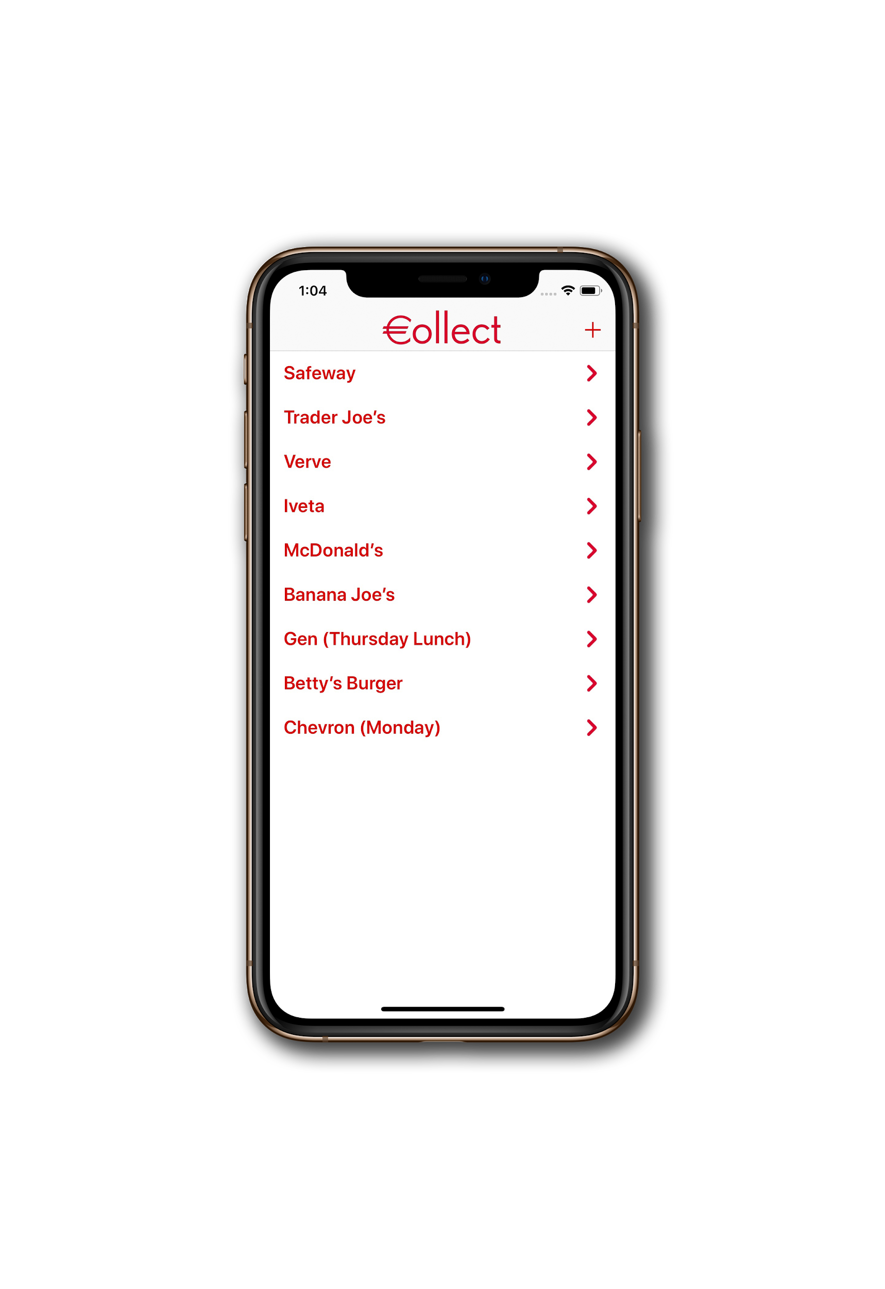


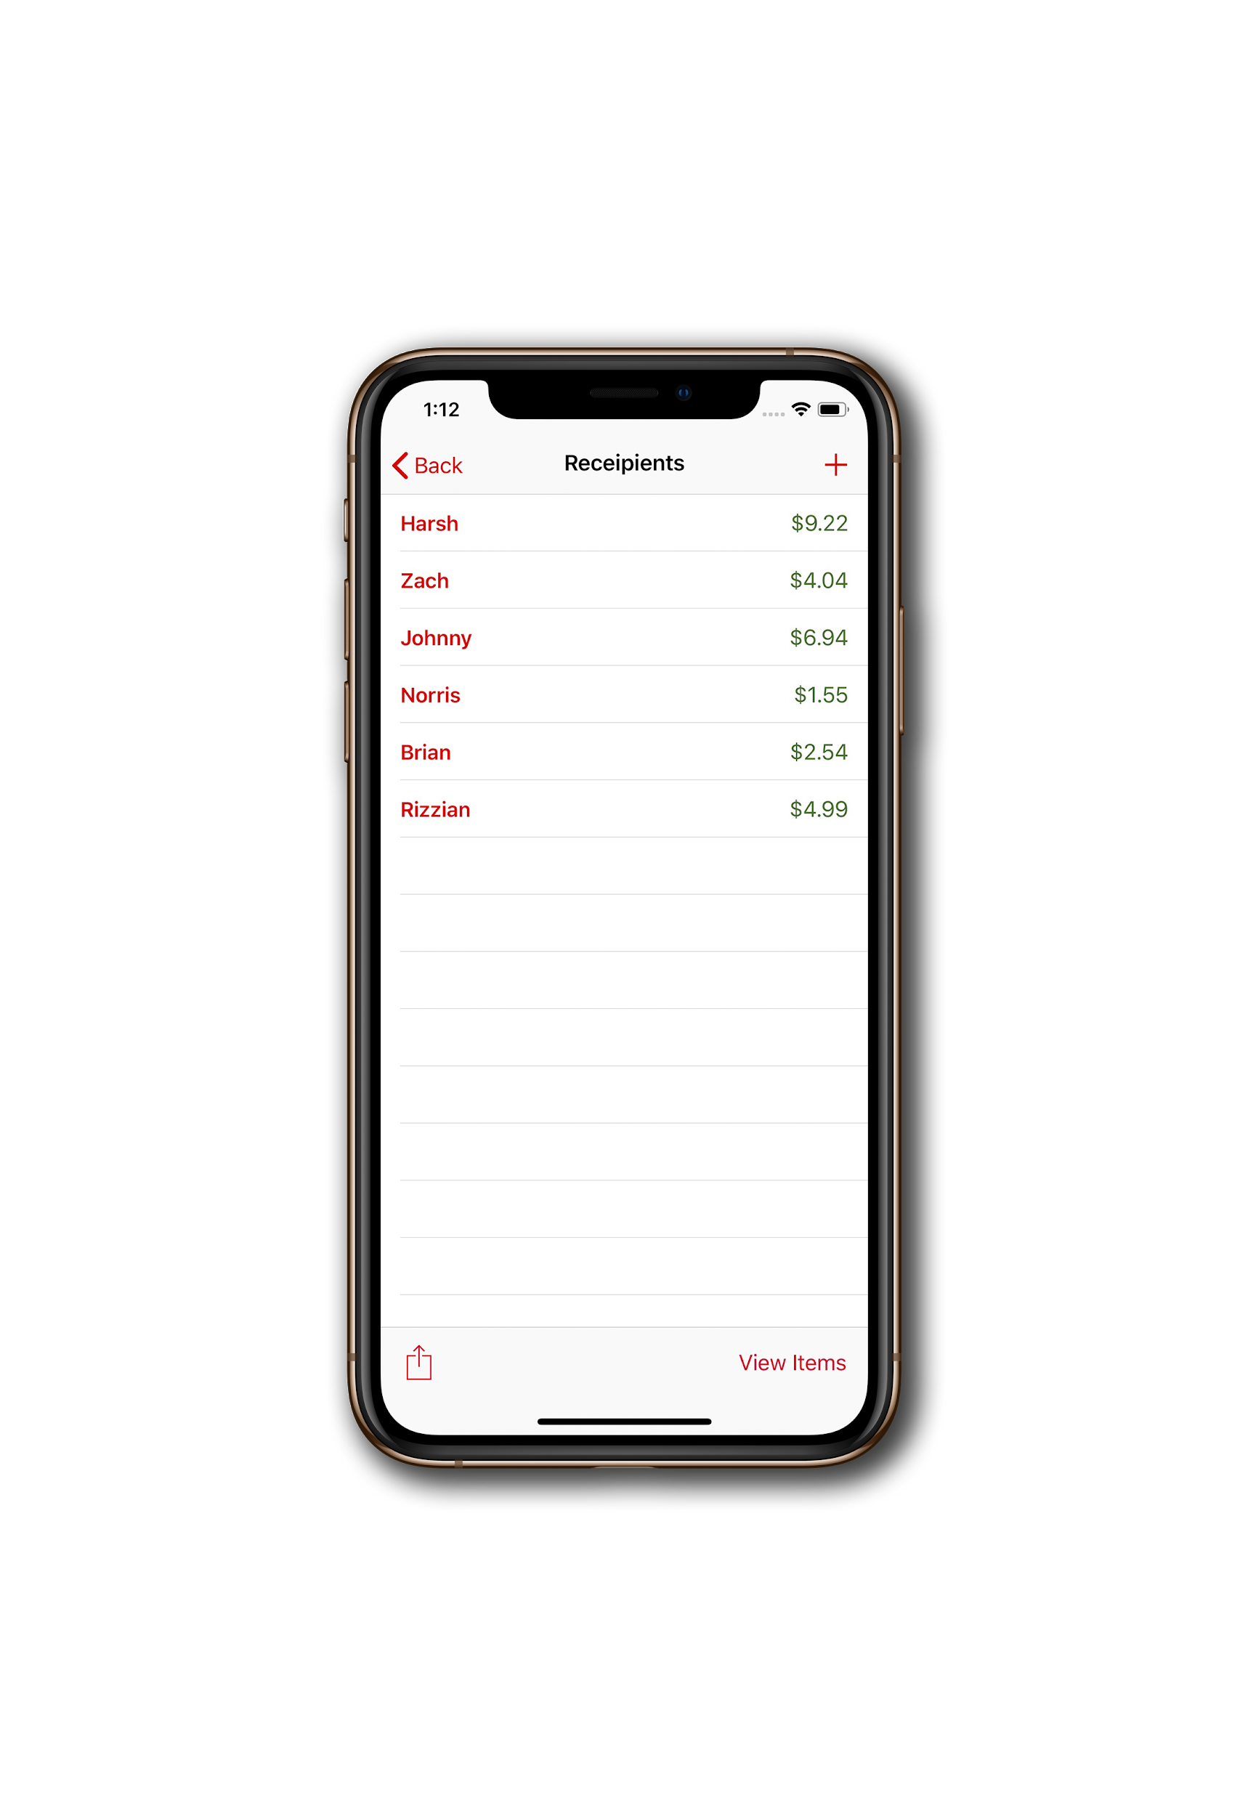
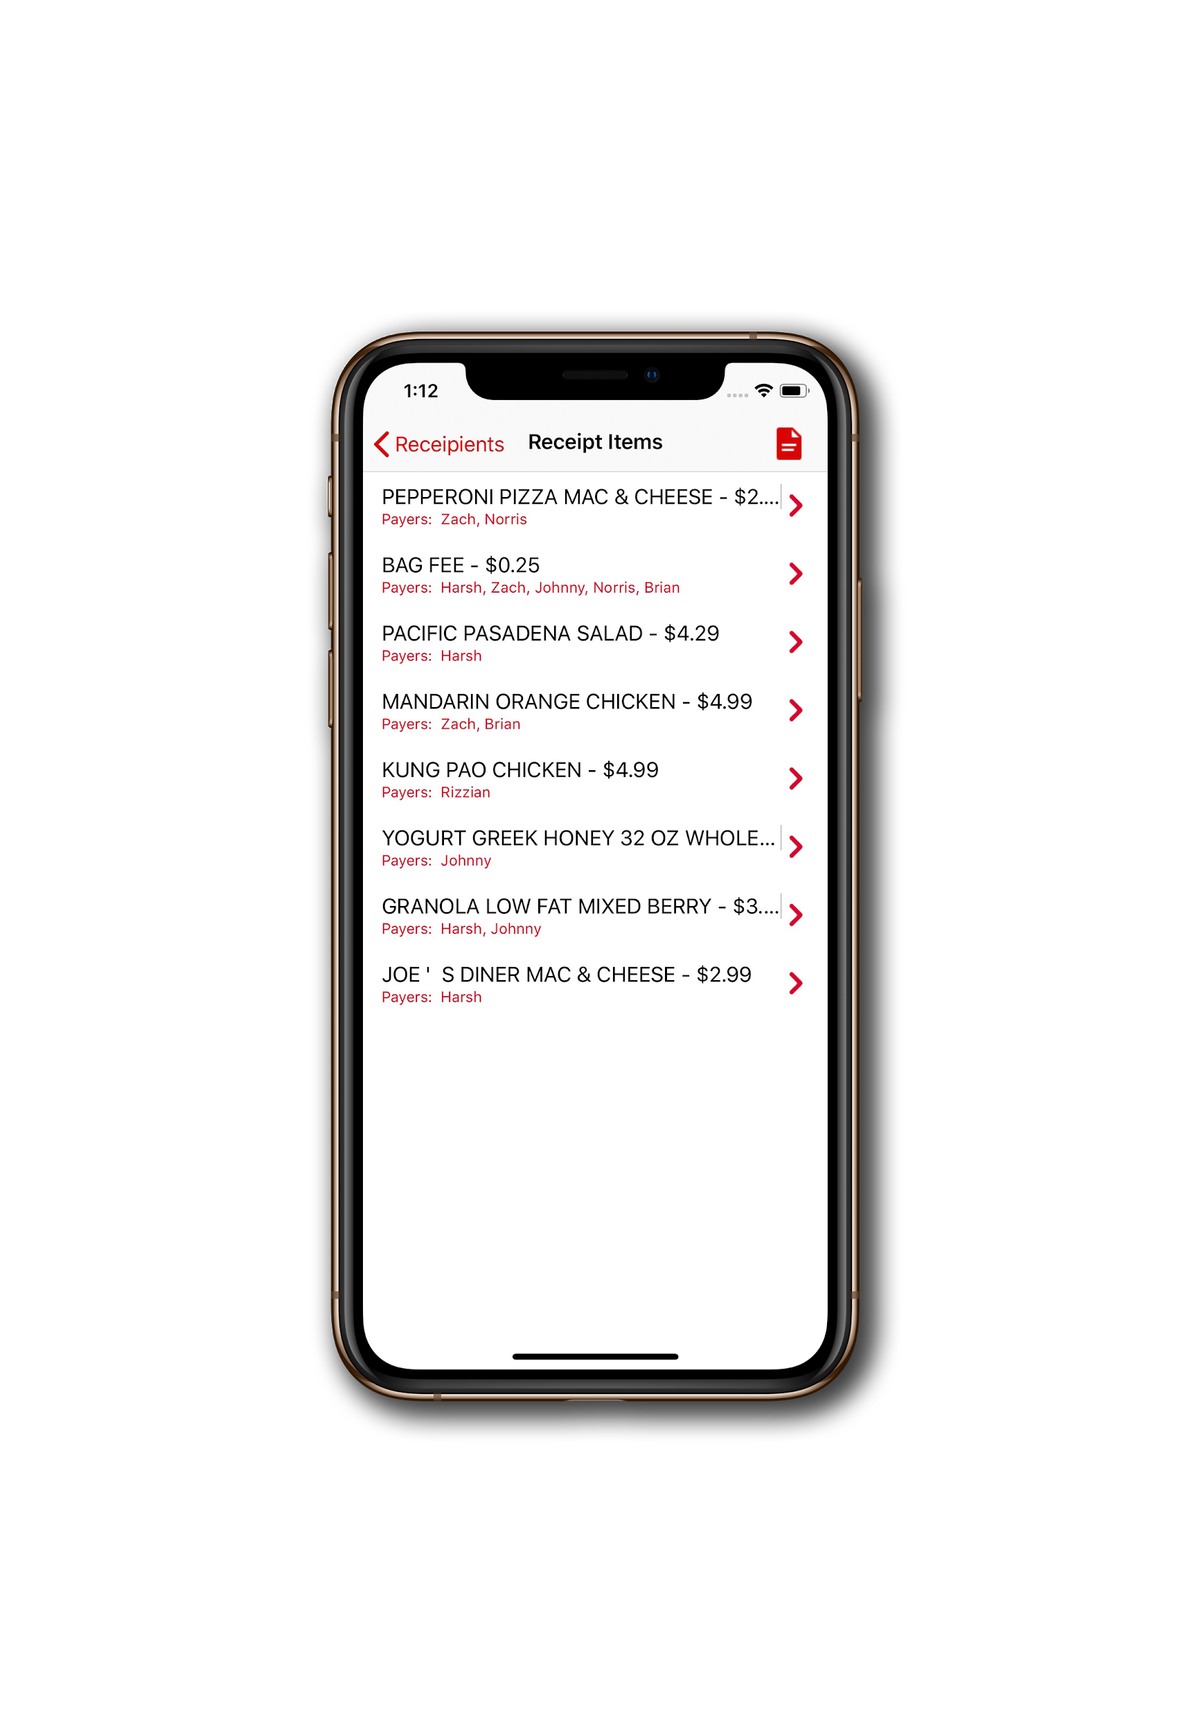
Brian Thyfault, Zachary Jicha, Harsh Karia, Norris Chan,
Johnny Palacios, Rizzian Tuazon

Slide 3
The Problem
Too often, one person ends up paying the bill for transactions among a group of people. That person, in addition to paying the full financial cost, has to manually split items as well as account for any additional fees. With modern technology, this problem should not exist. With Collect, our users will be able to intuitively split receipts among their peers.

Slide 4
Goals
Be able to scan receipts and save it to the phone
Be able to enter names into the app and assign items to be split among each name
Be able to have high level view of a receipt to see who owes what
Be able to share debts to people from the app
Be able to mark names as paid
Be able to login with a user system
Be able to send out transactions using 3rd party payment systems

Slide 5
Biggest Accomplishments
Achieved a minimum viable product
Learned how to use new technologies, APIs, and frameworks
Learned key PM practices such as proper code standards, version control, Git

Slide 6


Biggest Challenges
Learning curve
Unit testing
Underestimating time to complete tasks
Debugging
Deciding which backend database we wanted to use (i.e. Core Data vs. Firebase)

Slide 7
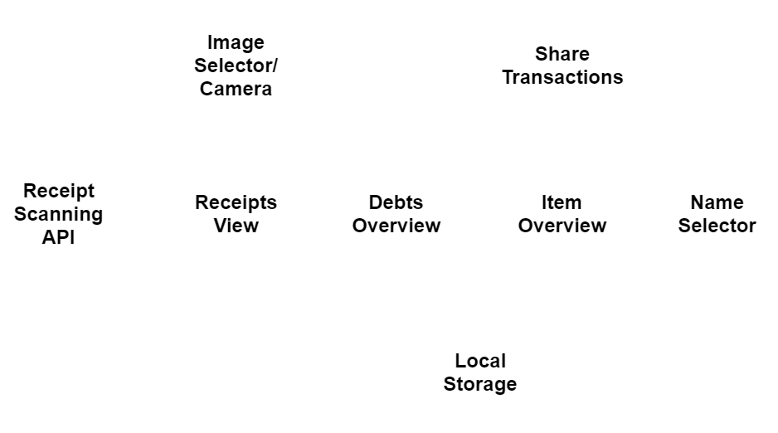
System Overview

Slide 8
Technologies
TagGun
Alamofire
SwiftyJSON
Core Data
Swift & Xcode

Slide 9
PM Techniques
Trello (for Scrum board)
GitHub (Version Control)
Scrum meetings every day
15 minute standup
Remainder of time spent on development

Slide 10
Things we...
Enjoyed 😃
Everyone helping each other out
Working with people with different backgrounds
Seeing our project come into completion
Didn’t Enjoy 😔
Being on a constant time crunch
Learning Core Data
Merge conflicts

Slide 11
Lessons Learned...
What worked/what we will keep doing:
Agile Process
Scrum Meetings
Constant Code Committal
What didn't work / what we should have done
Better Communication
Code: Style Guide
Have in-app payments

Slide 12
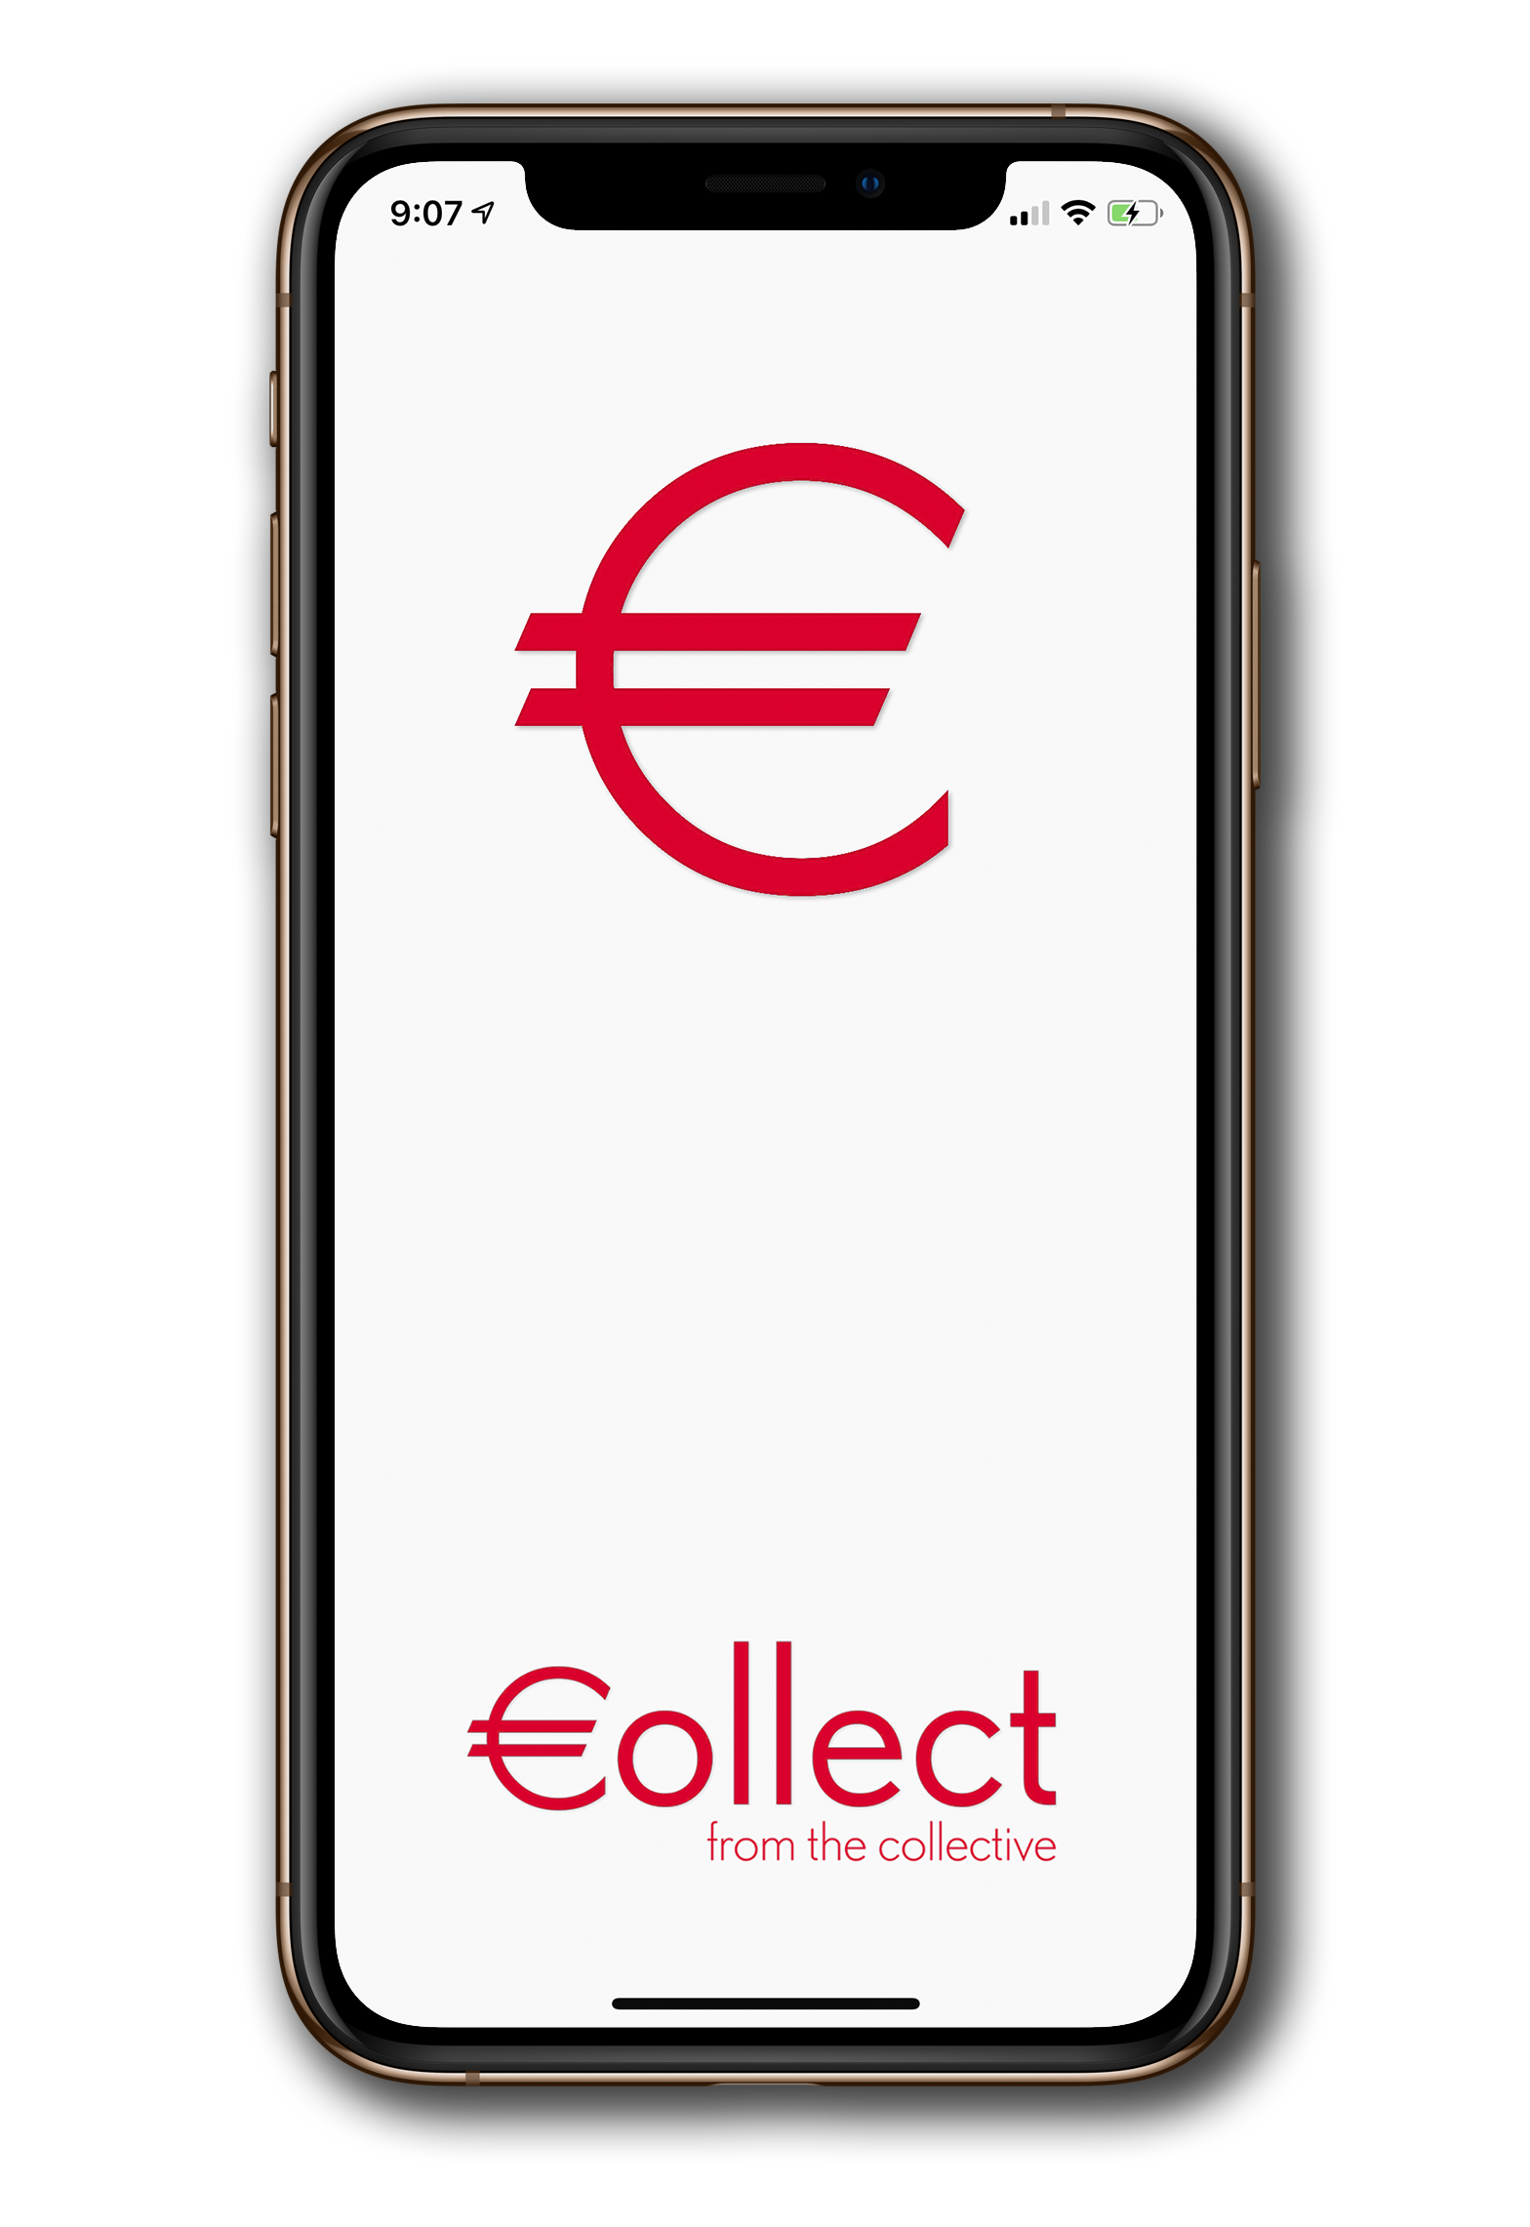
Splash Screen

Slide 13
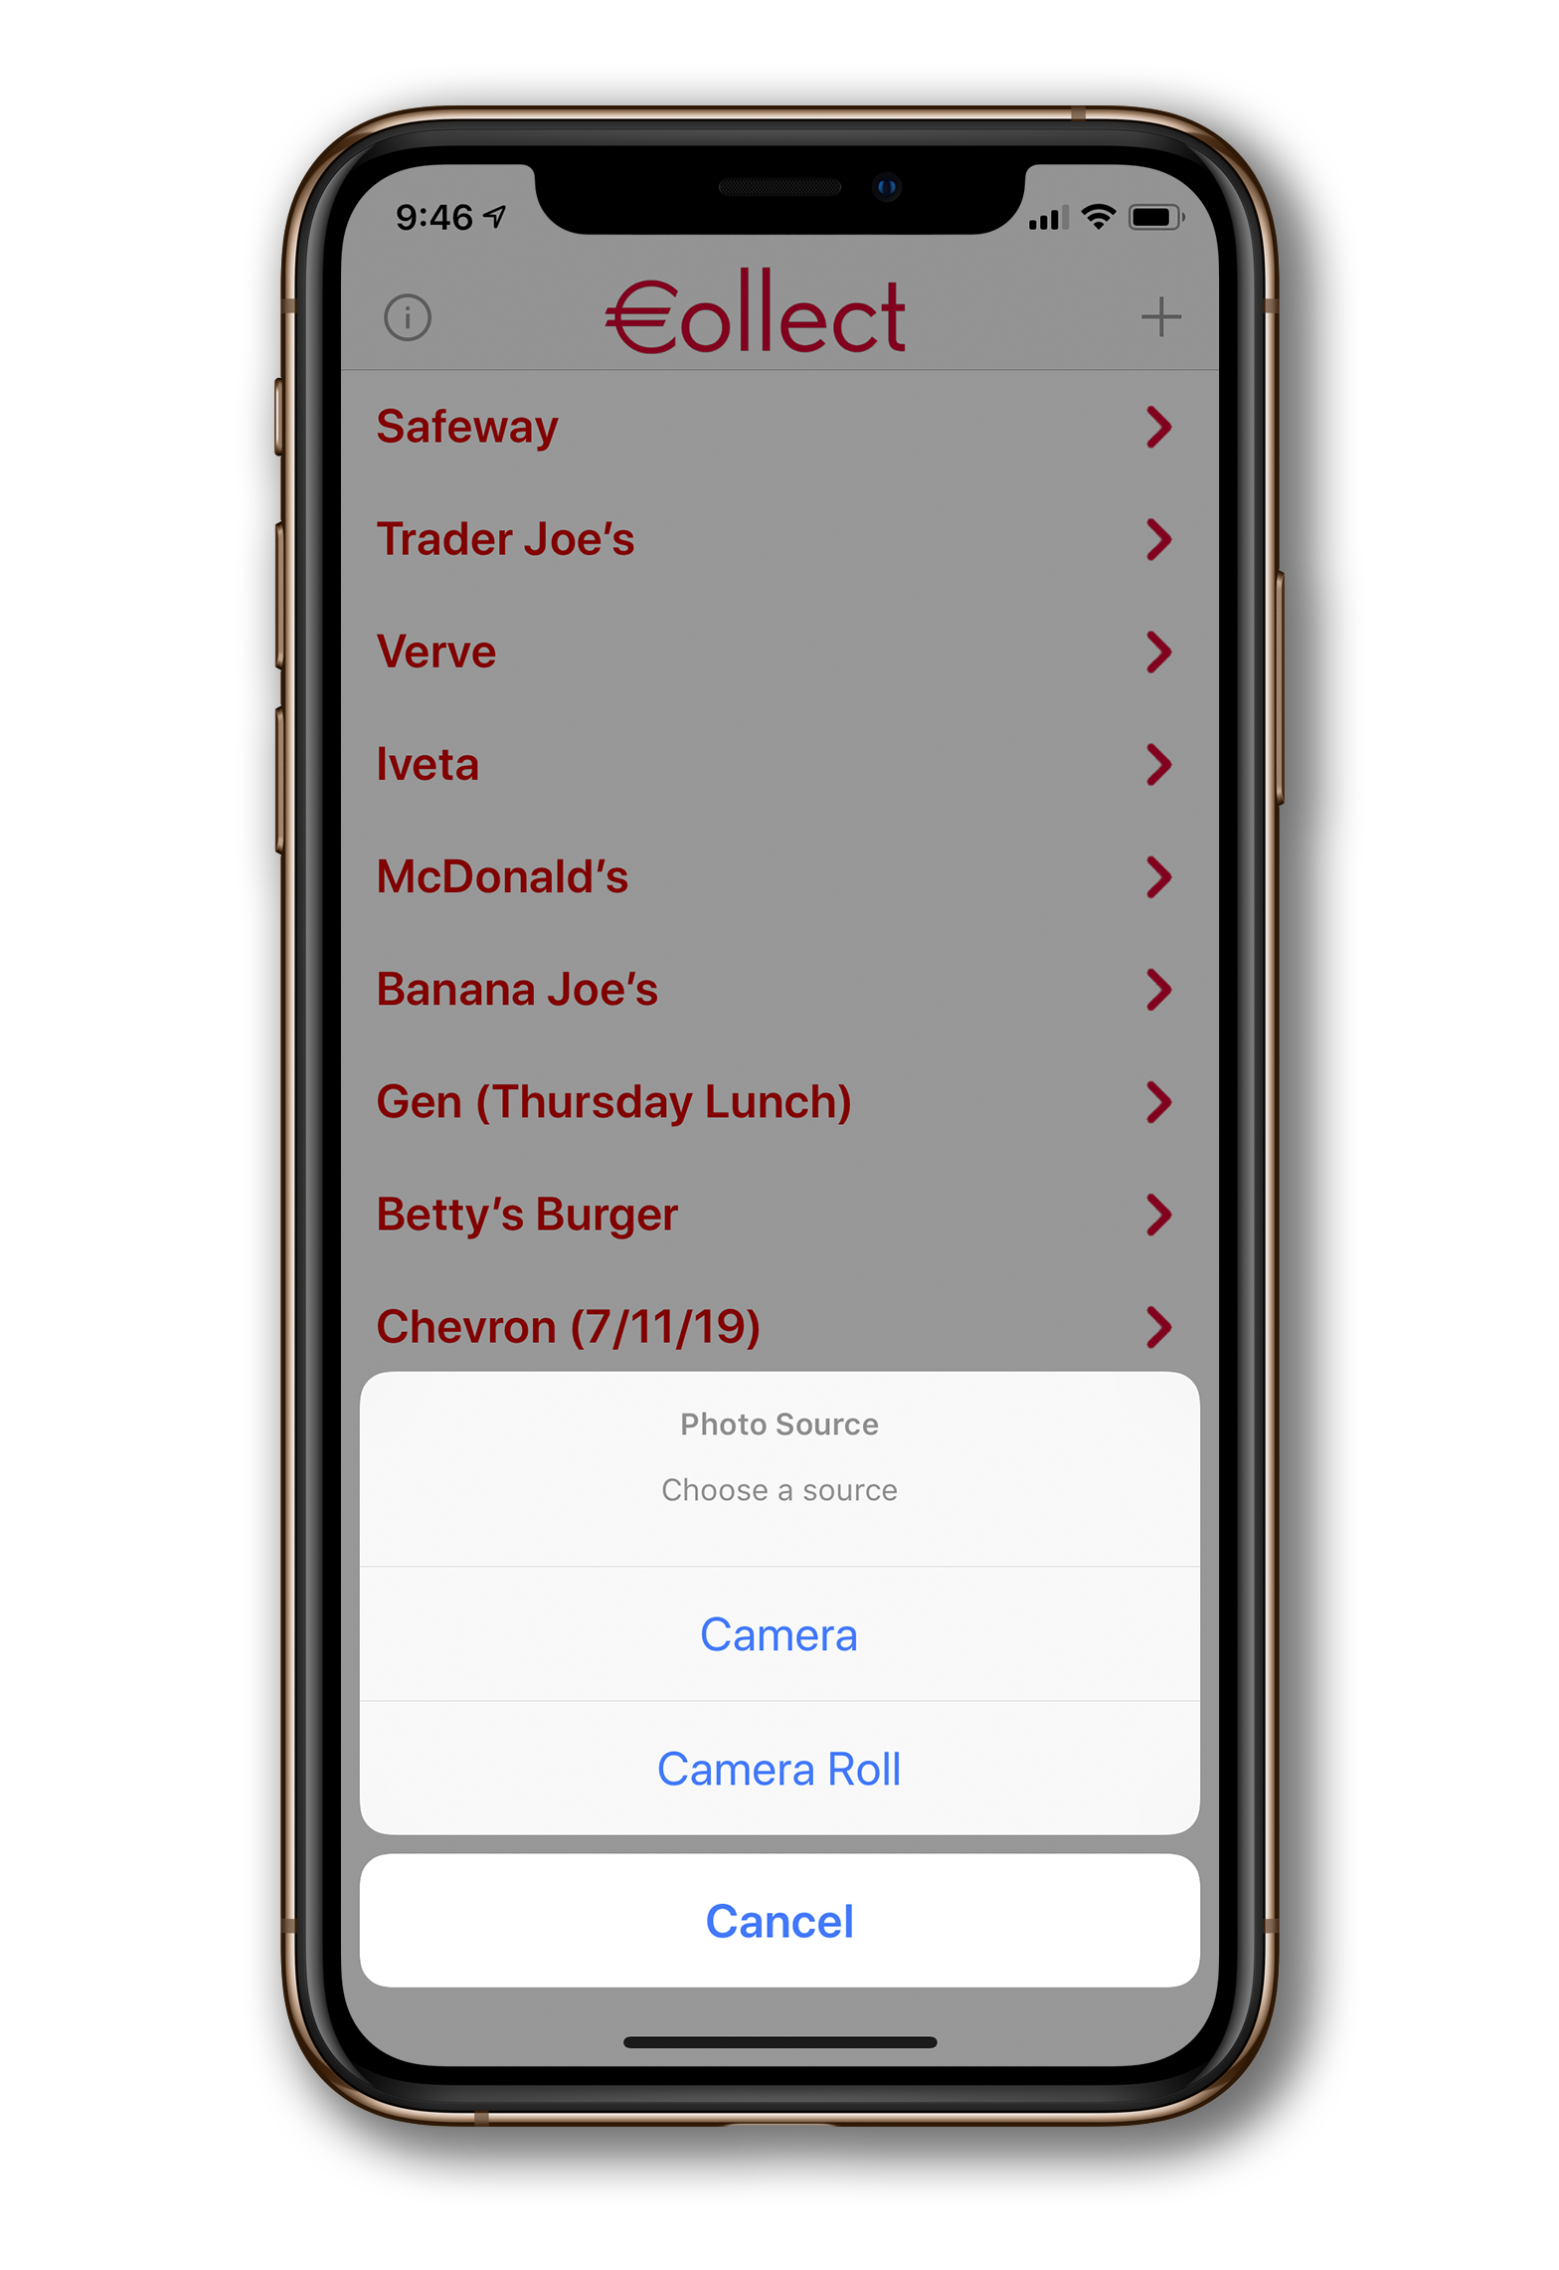
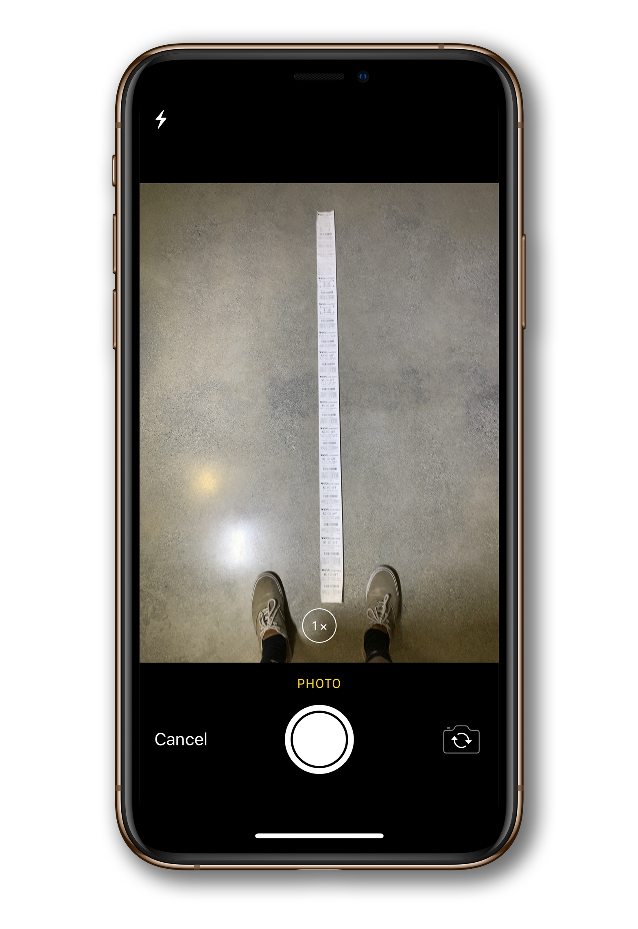
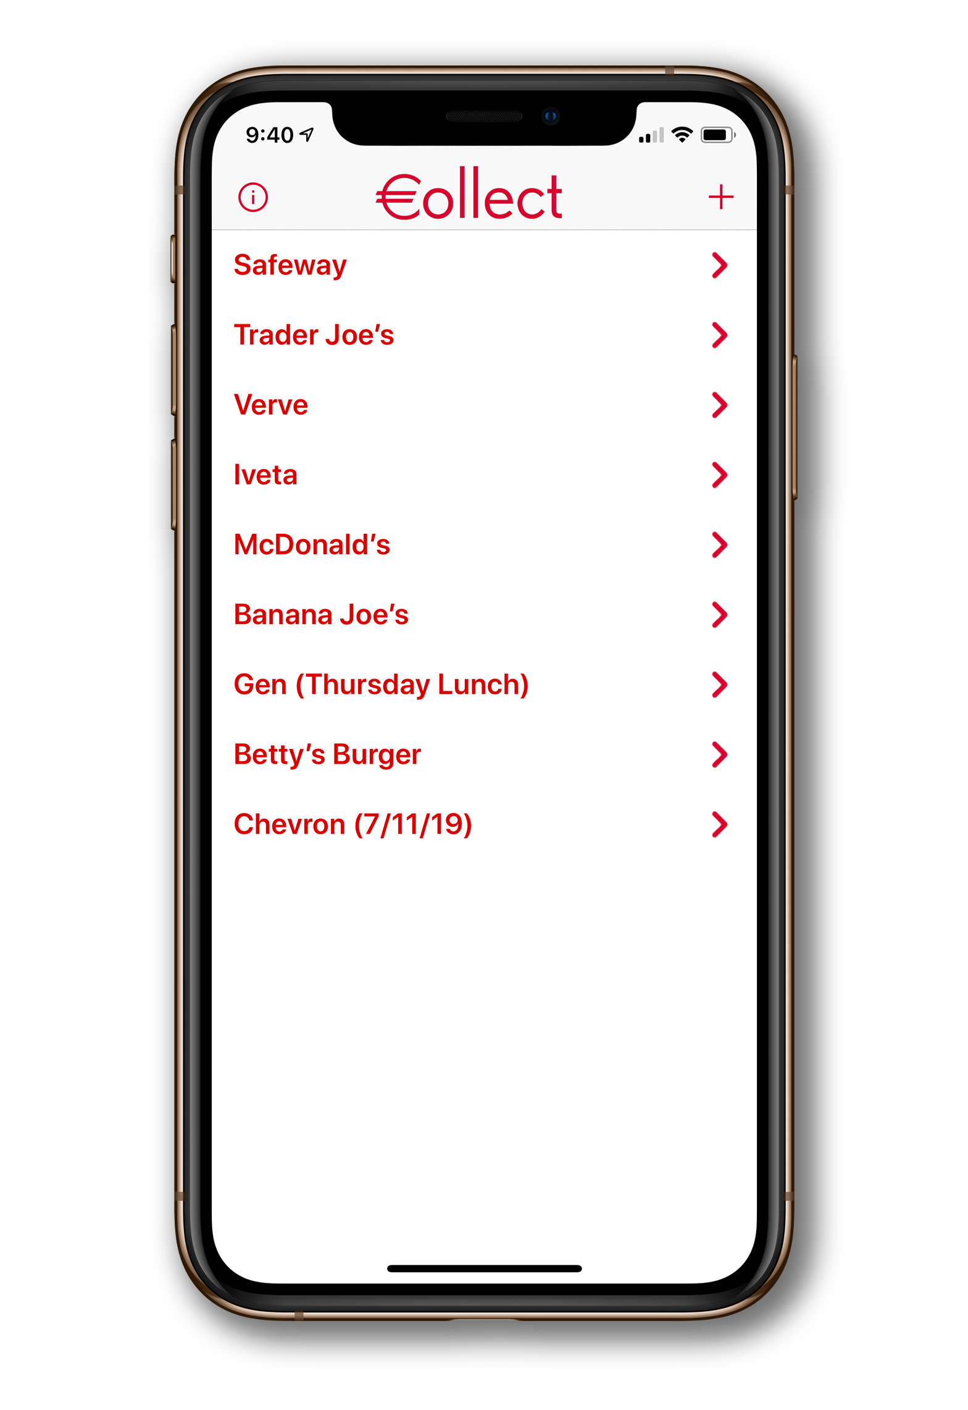
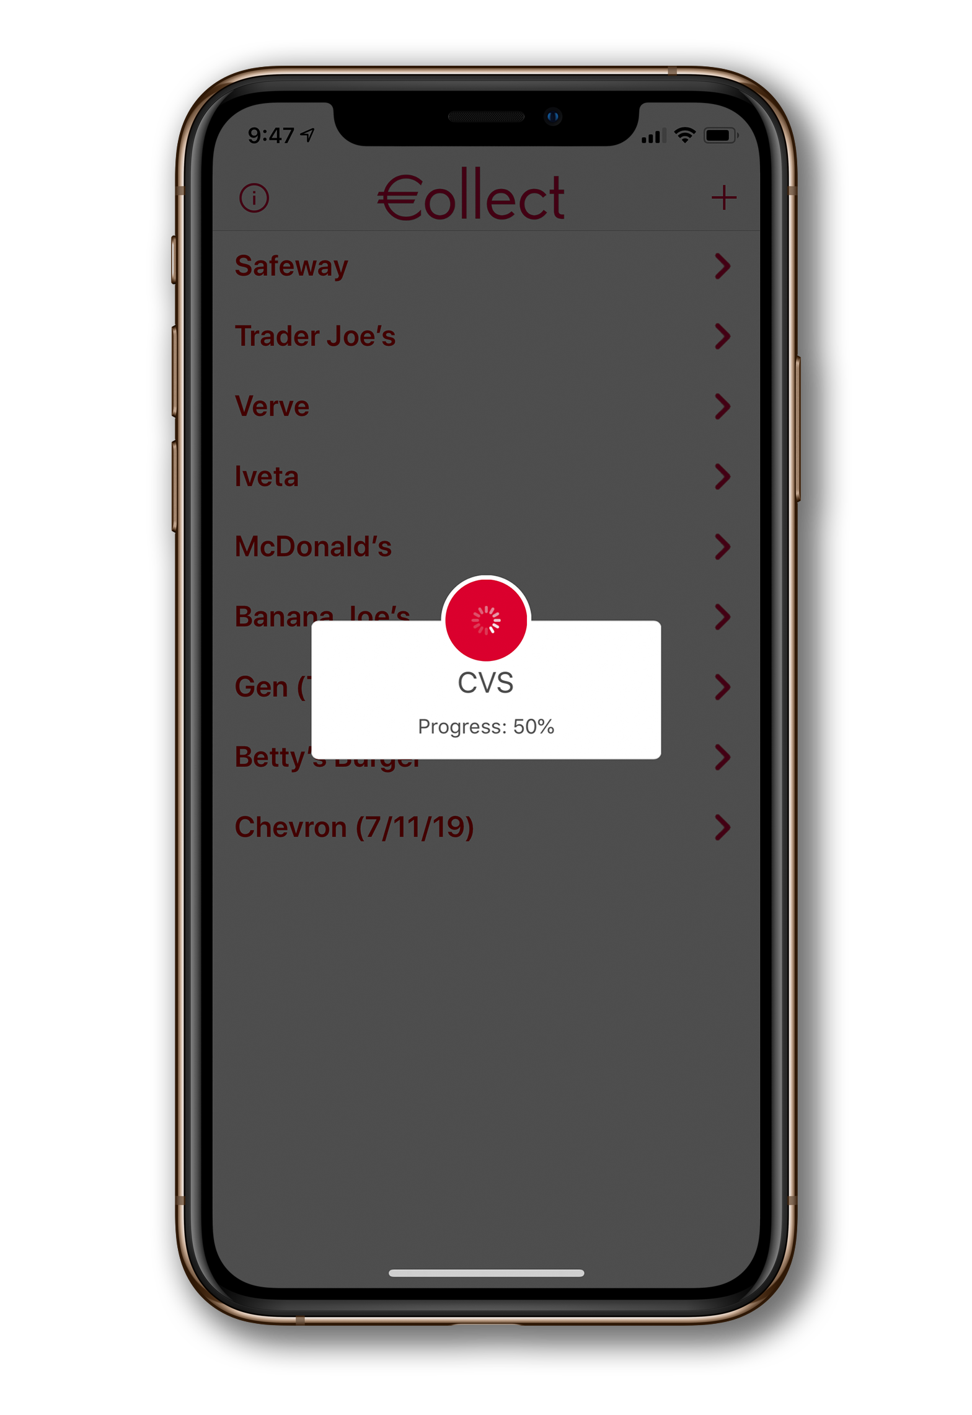
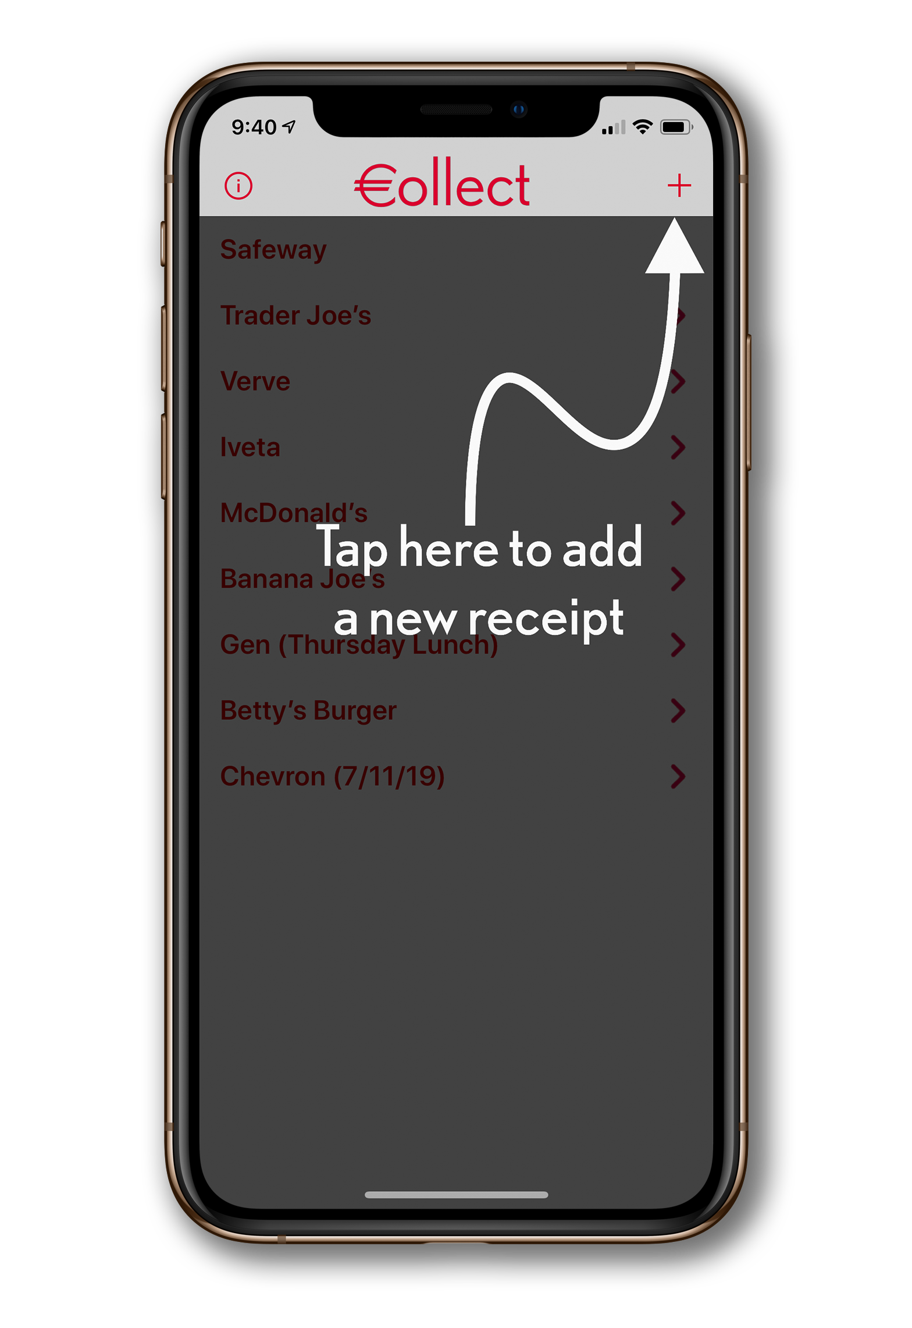
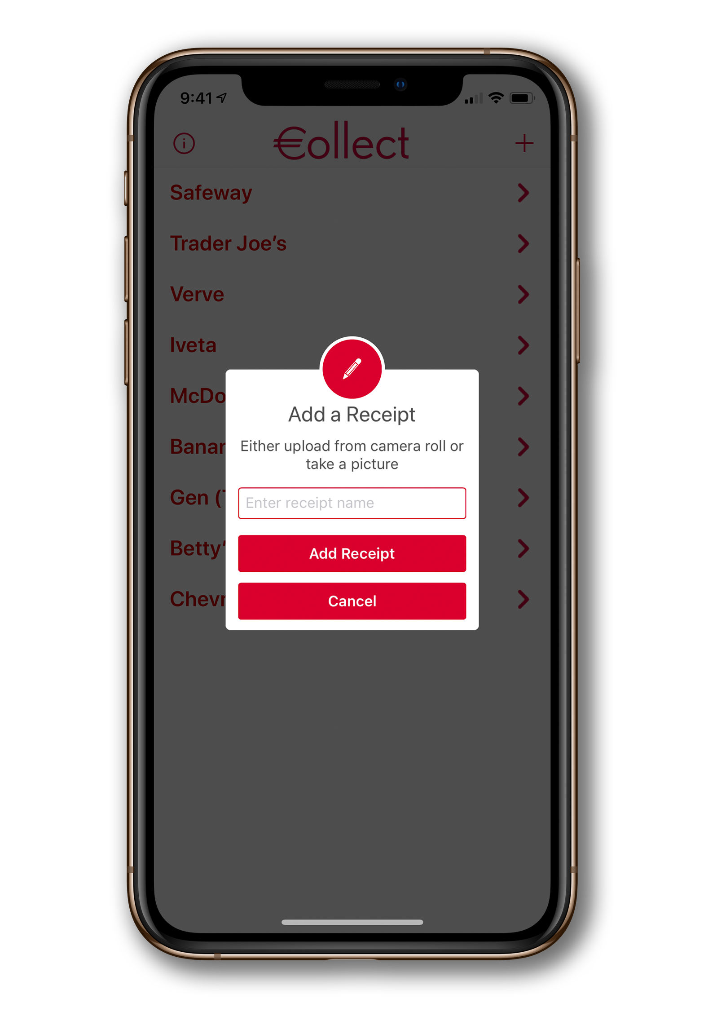
Home Screen

Slide 14
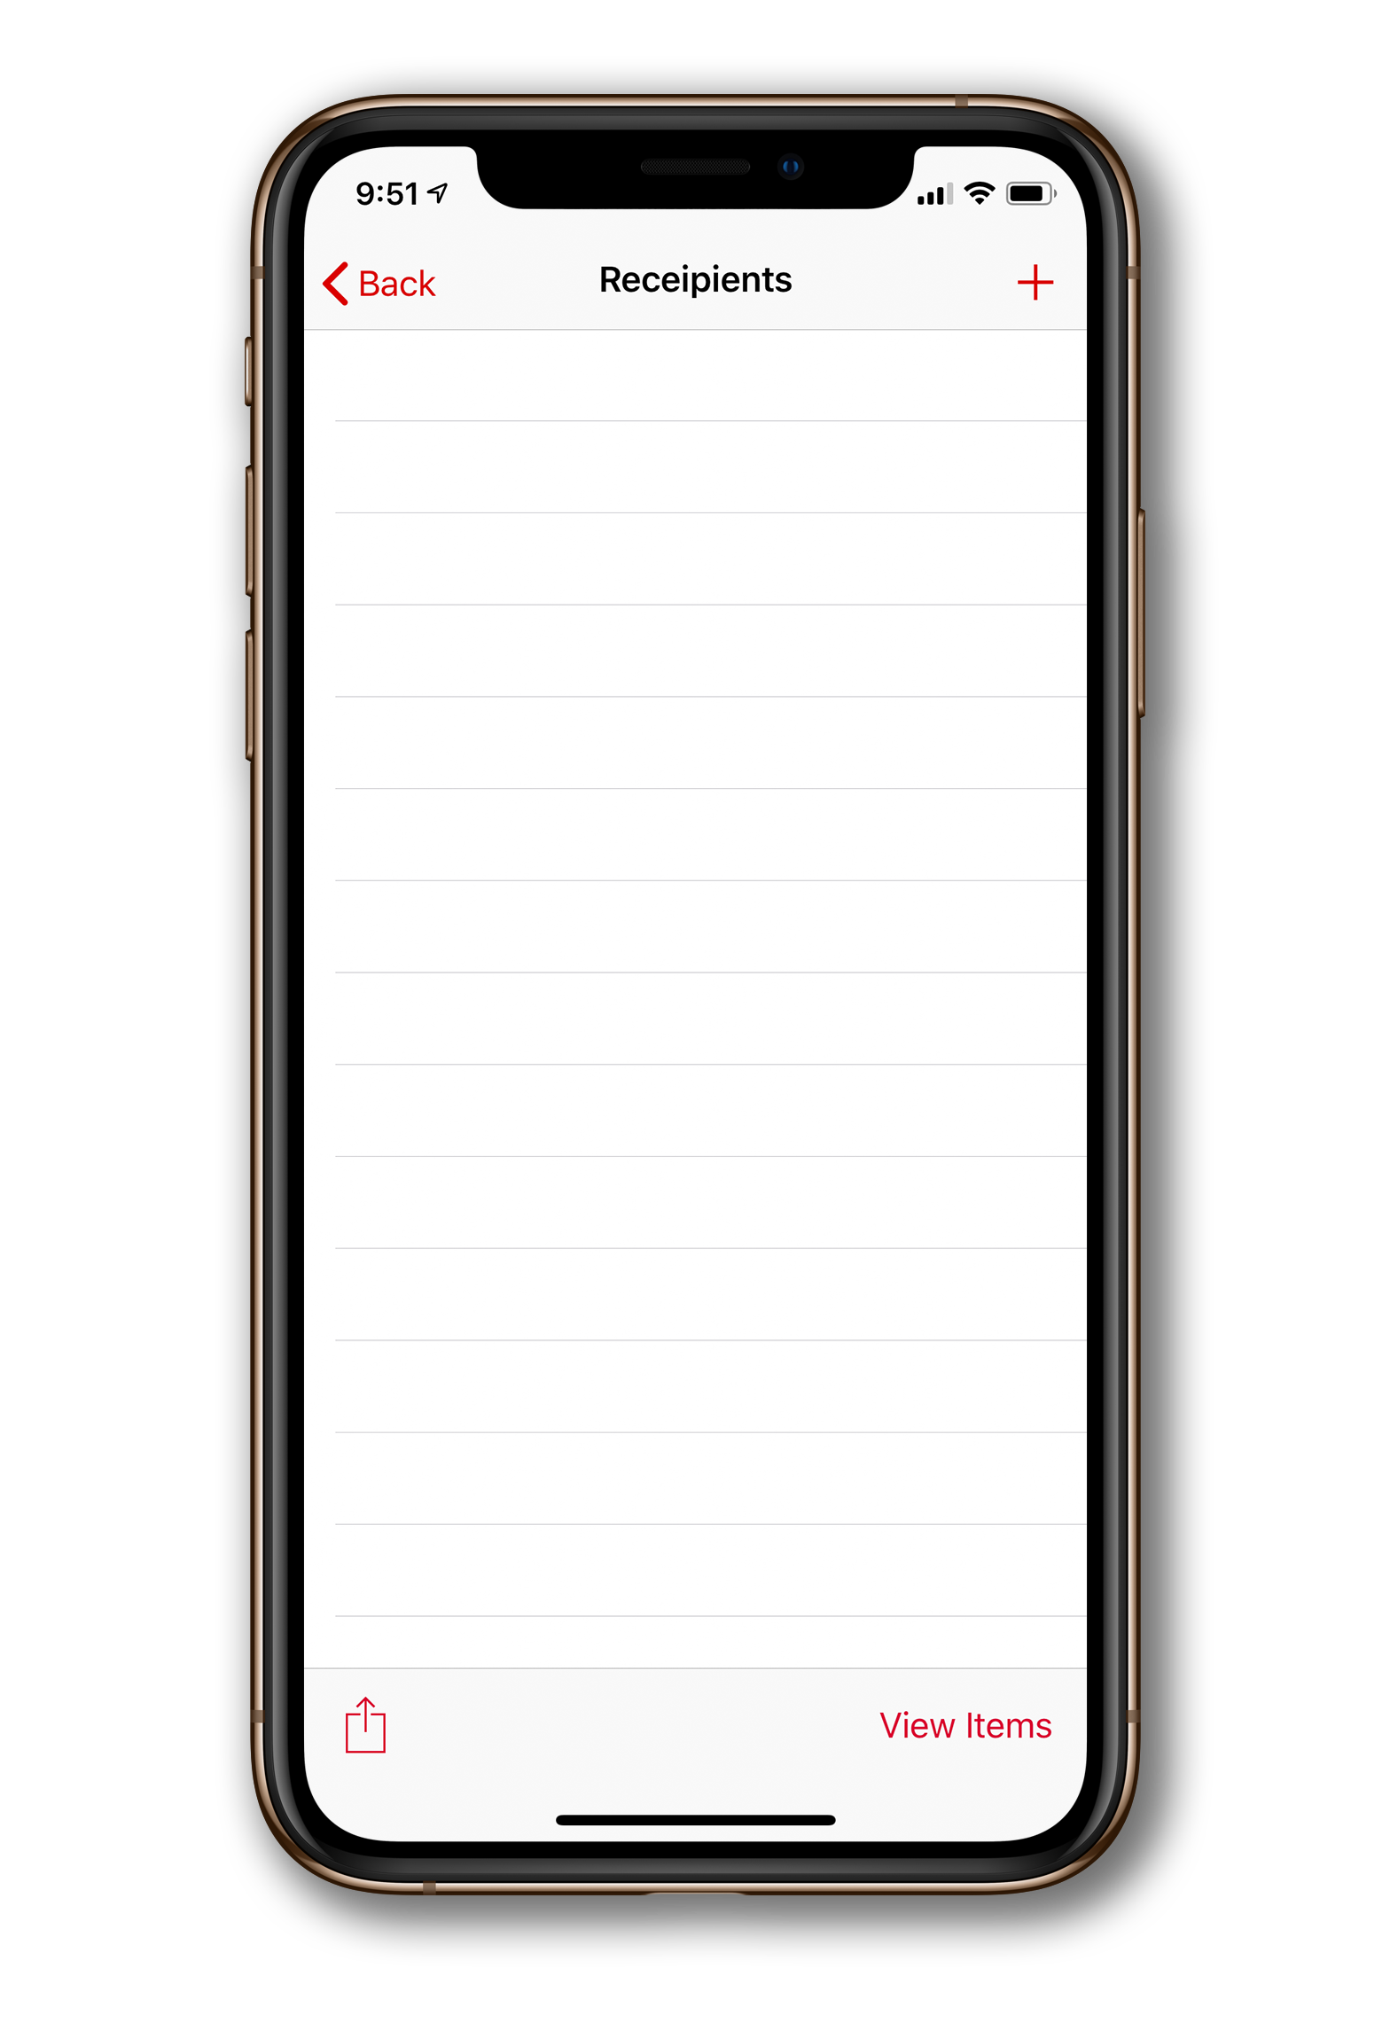
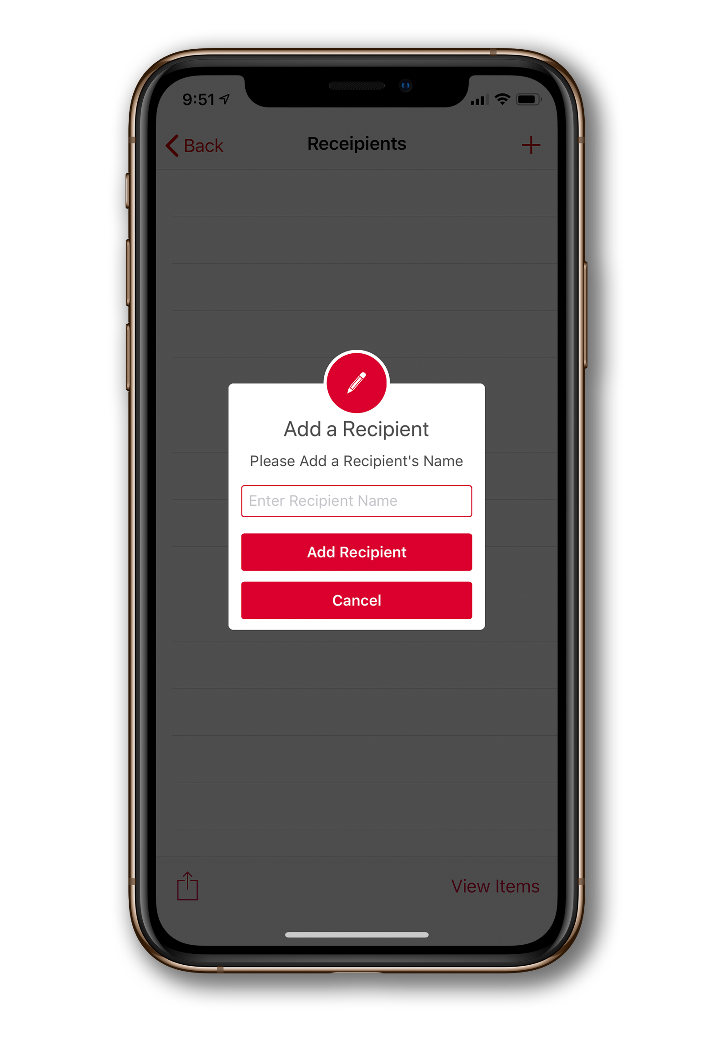
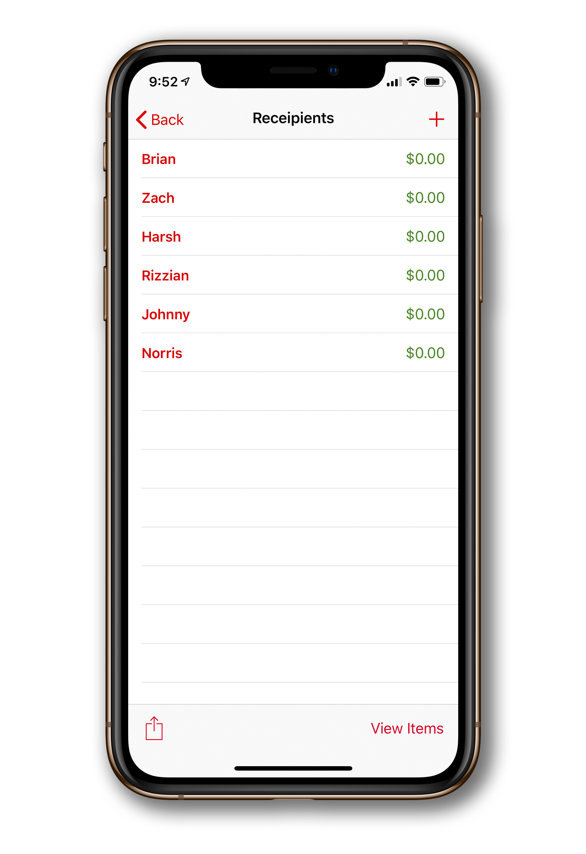
Recipient View

Slide 15
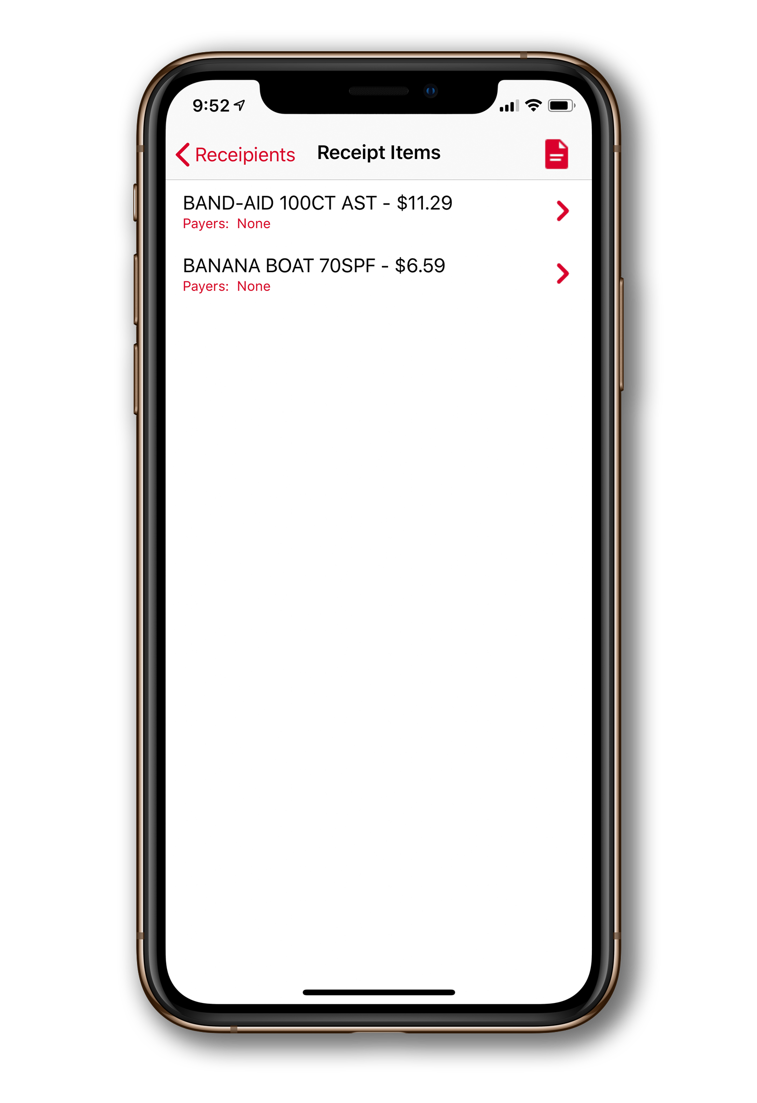
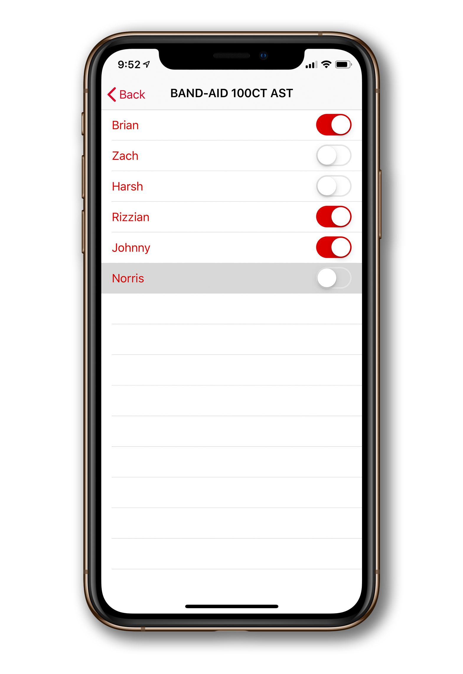
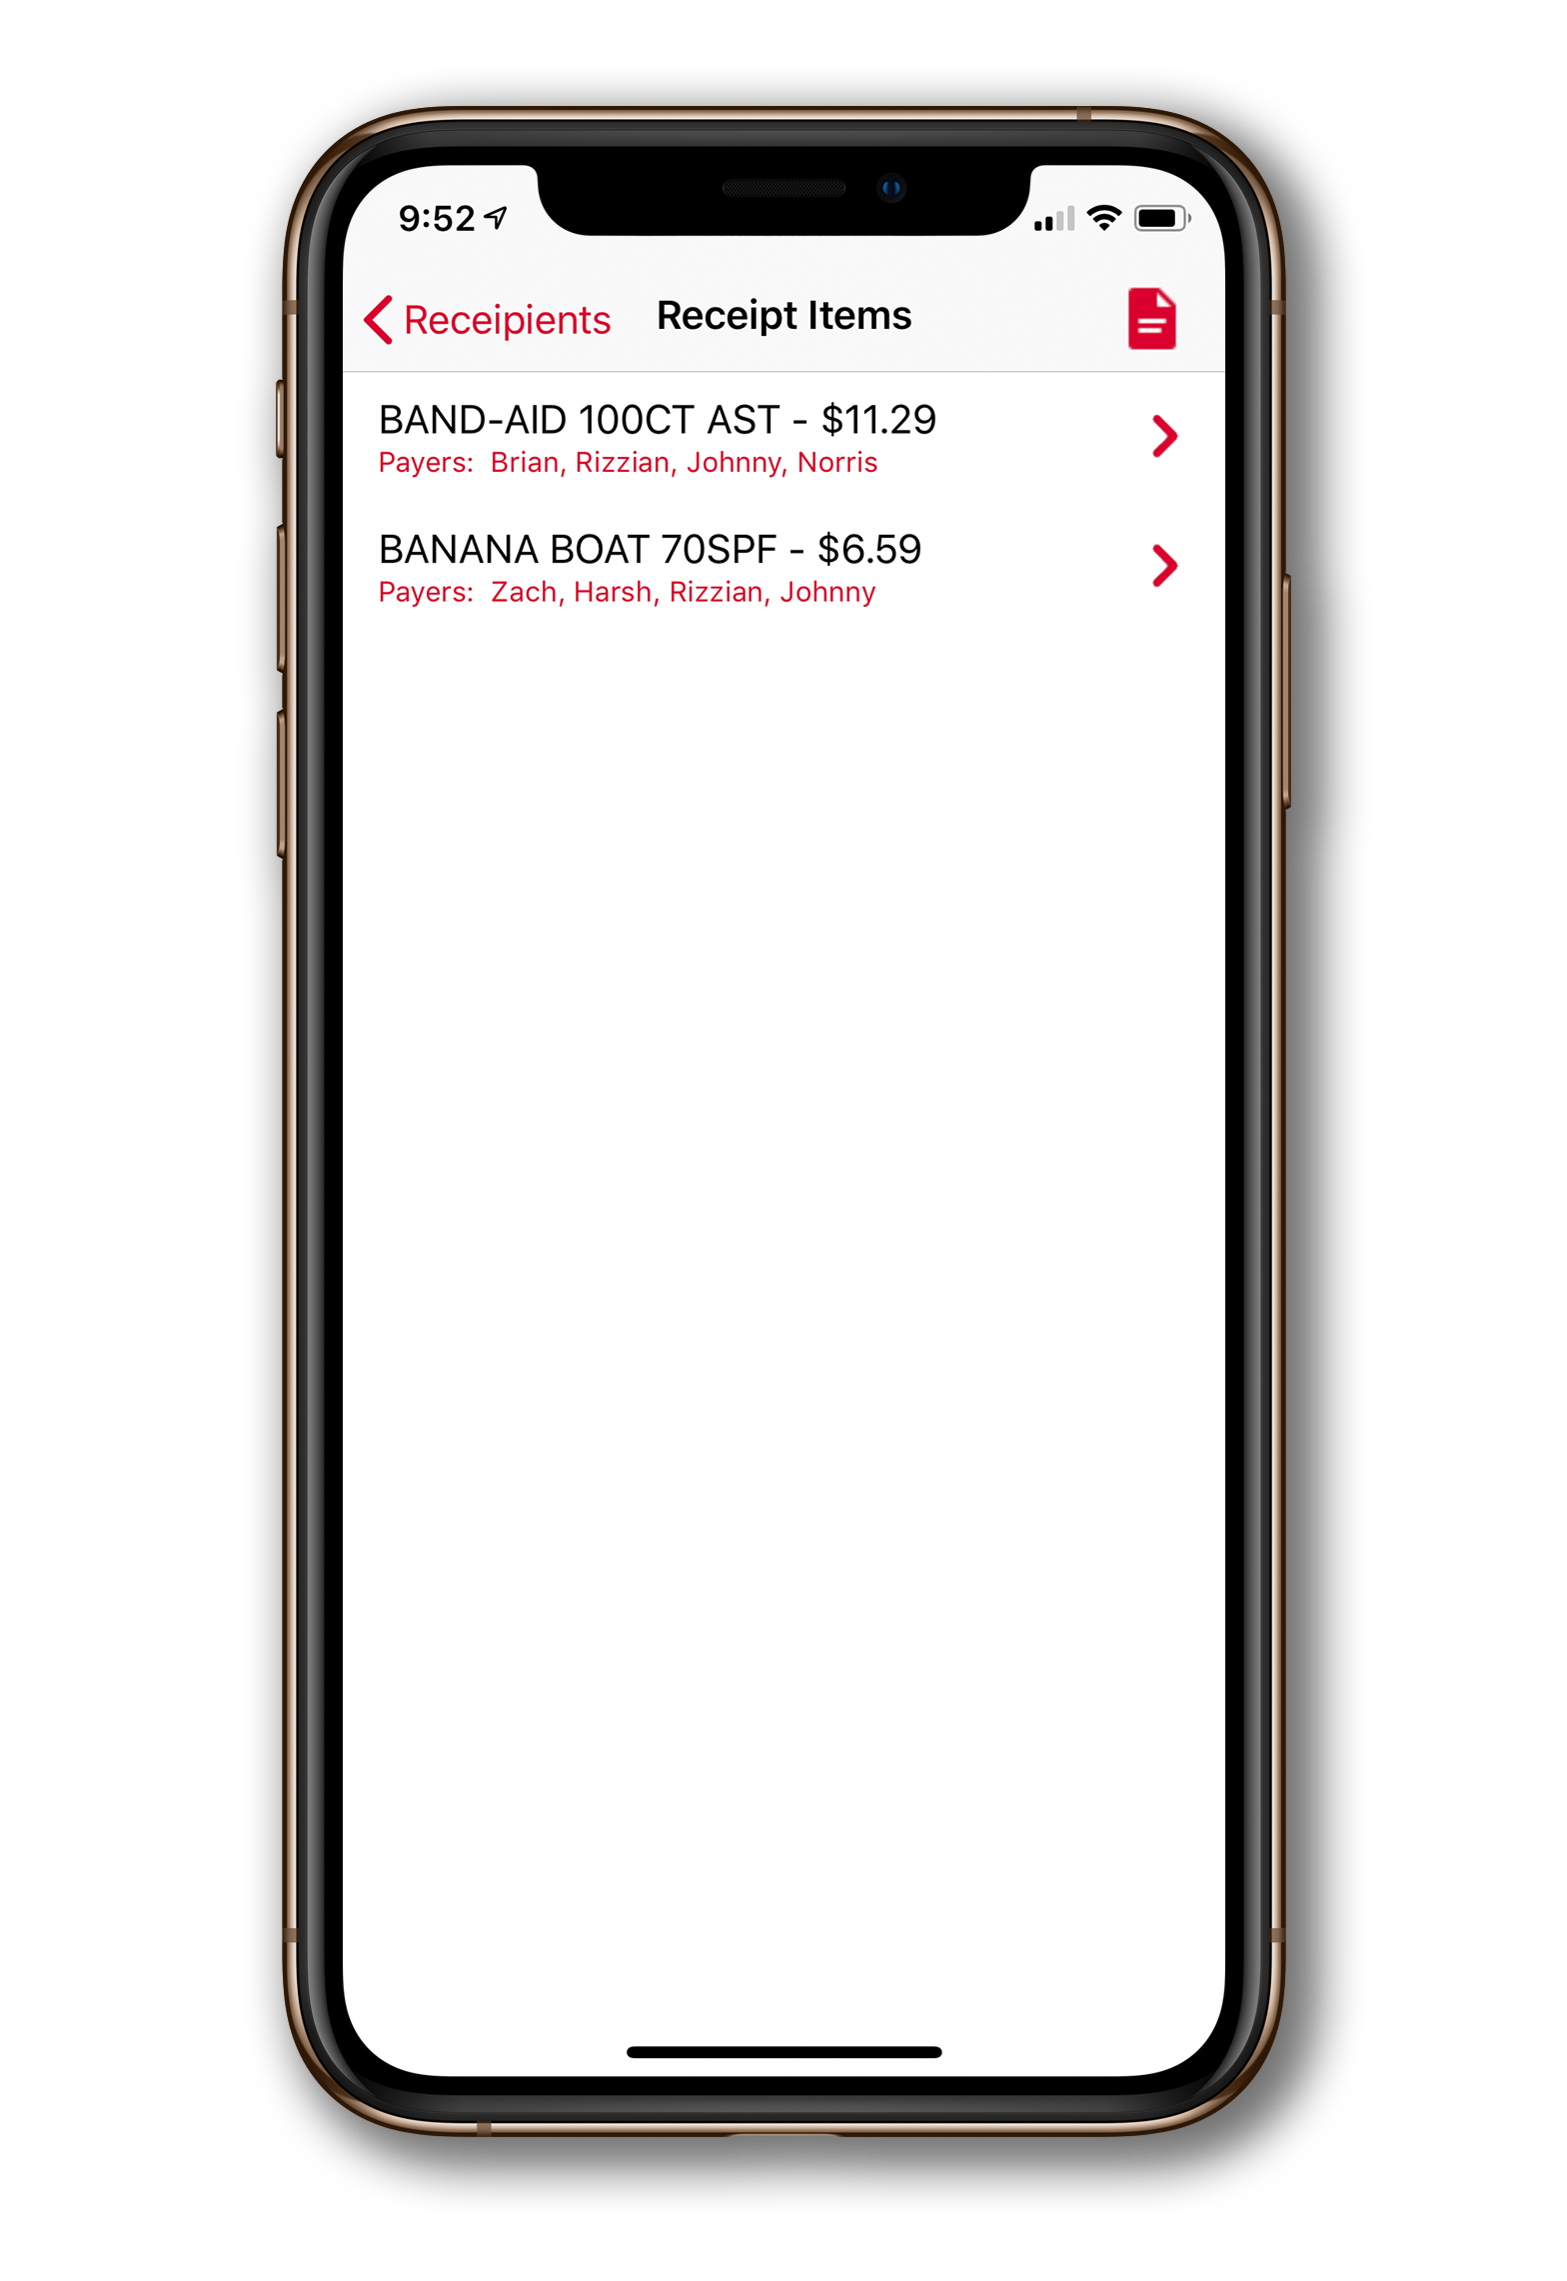
Receipt Item List

Slide 16
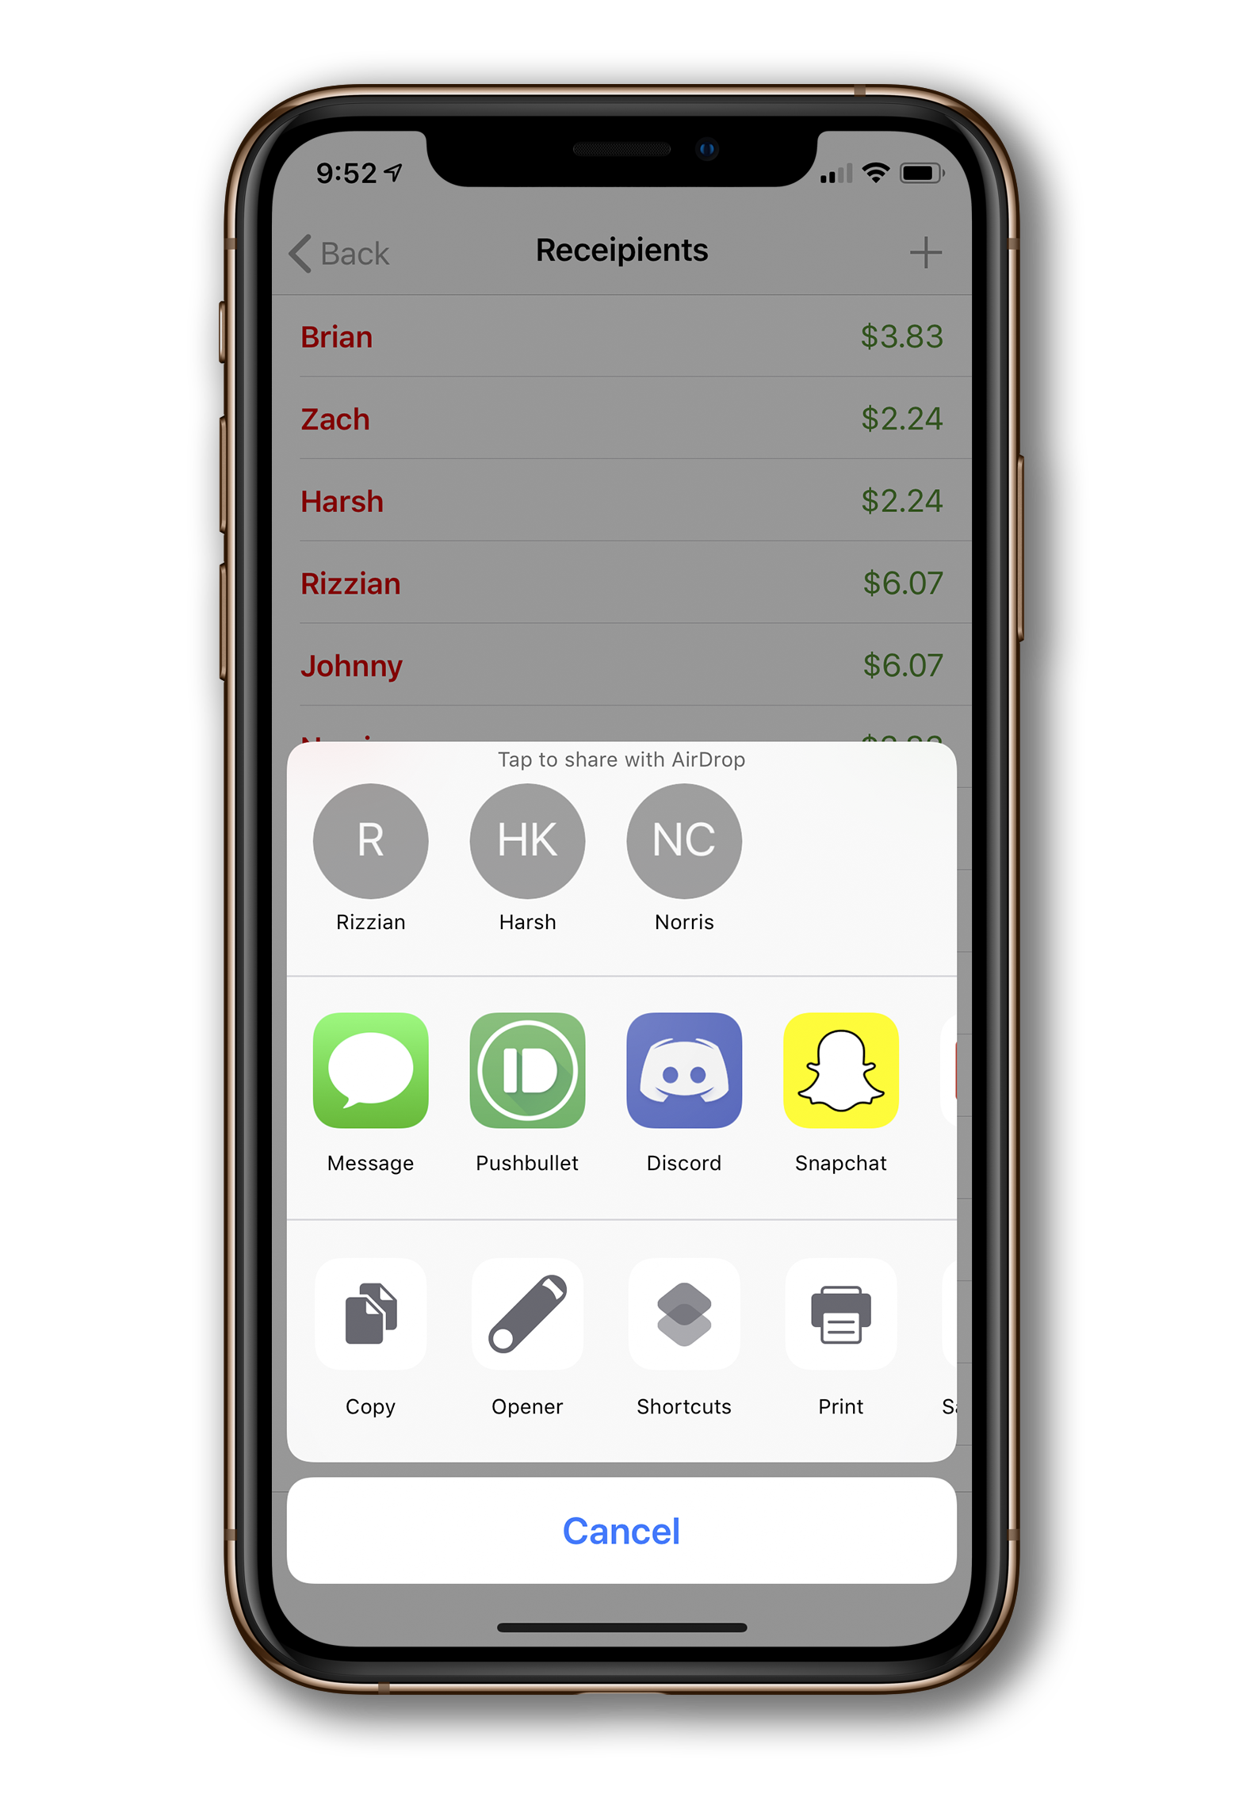

Recipient
View

Slide 17
Thanks!
Any questions?

